Slide 1
Scanning Tunneling Microscopy (STM)
Hui-Xin Shih

Slide 2
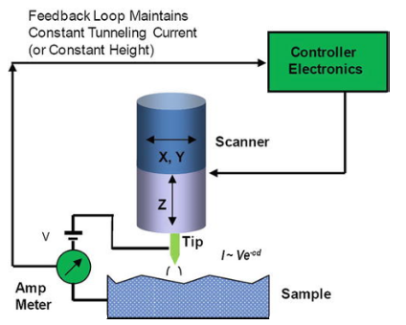
Introduction to STM
STM was developed by Binnig and Rohrer in 1981.
STM relies on quantum tunneling: with a bias applied, electrons tunnel across the vacuum gap between a conductive tip and the sample
Operating in ultra-high vacuum (< 10⁻¹³ Torr) at 4.2 K (liquid helium temperature)

Slide 3
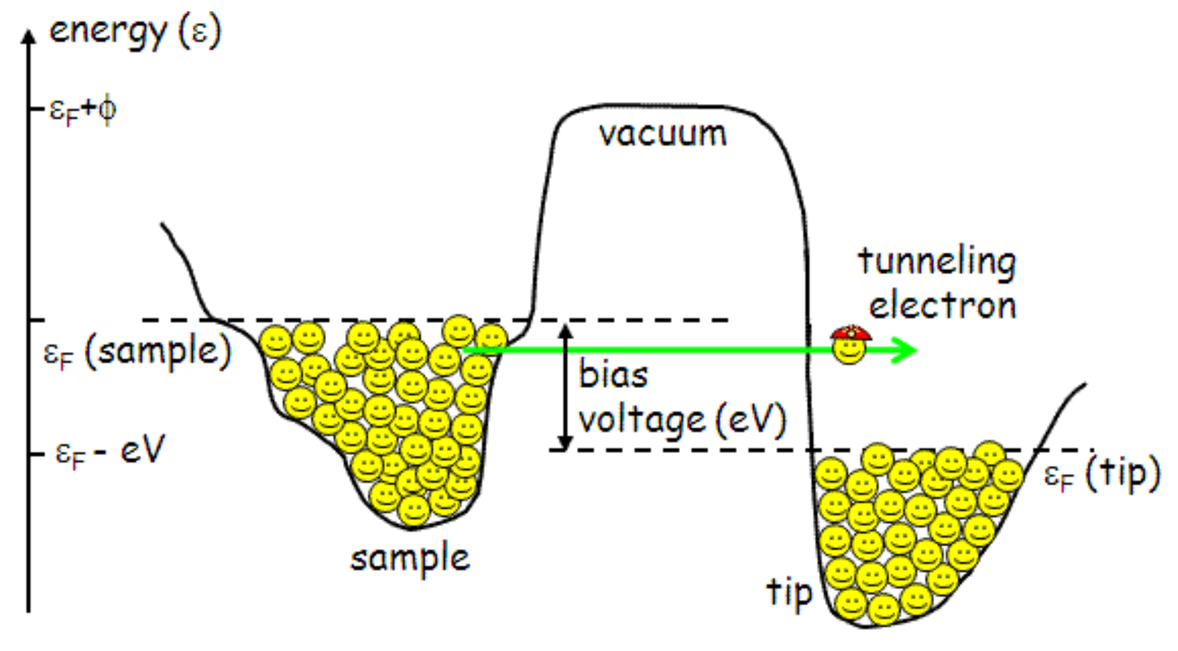
The tunneling current
Bias voltage shifts the sample Fermi level relative to the tip, creating empty states for tunneling
Under negative sample bias, electrons tunnel from filled sample states into empty tip states.
The tunneling current depends on the applied voltage and the available electronic states
➔ STM can probe the sample density of states

Slide 4
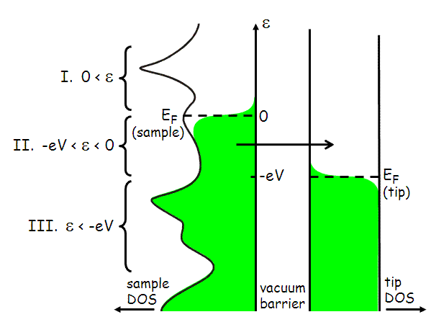


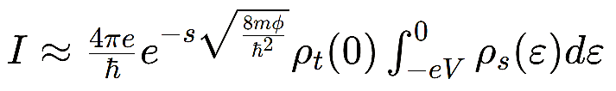
More technical details
The current depends on the availability of filled sample states to empty tip states, modeled by:
At 4.2 K, the Fermi function is abrupt, simplifying the integral to
The matrix element M² captures the exponential decay through the vacuum barrier, based on the work function and distance
The total tunneling current is exponentially sensitive to tip-sample separation

Slide 5
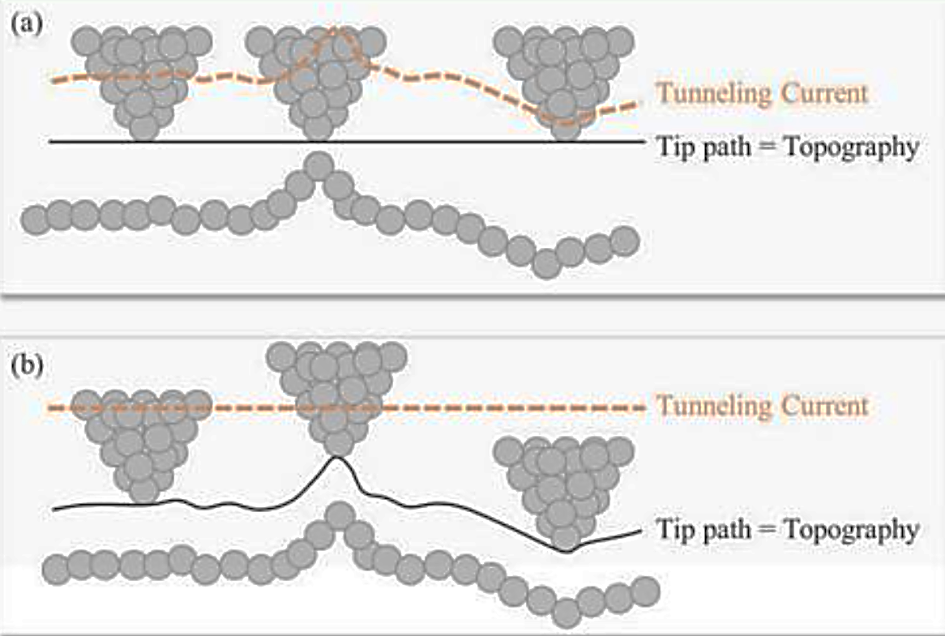
Operating Modes of STM
Constant-Height Mode:
  Tip scans at a fixed Z-scanner position without height feedback.
  Surface topography is directly mapped by measuring variations in the tunneling current.
Constant-Current Mode:
  Uses the tunneling current as a feedback signal to adjust tip height.
  Surface topography is mapped by recording the Z-scanner's vertical movements.

